Slide 1


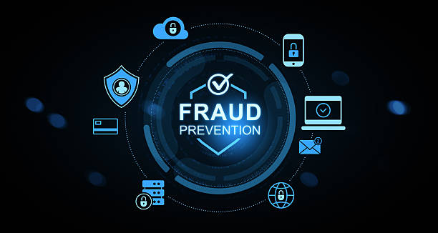

finovifi.com
2026 ACH Fraud Monitoring:
What Financial Institutions Need To Know

Slide 2
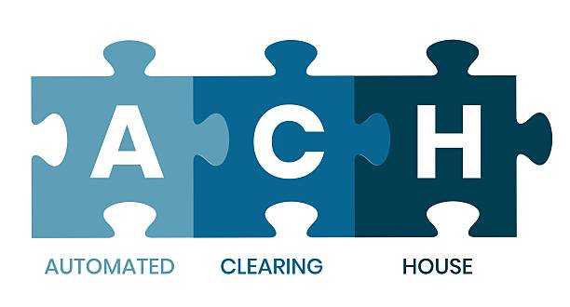

ACH 2026 Rules
Rule Overview
In 2026, Nacha is enforcing new fraud monitoring requirements designed to strengthen detection and prevention of ACH fraud — particularly fraud involving unauthorized transactions and those authorized under “false pretenses”.

Slide 3

Timeline / Phased Implementation
Phase 1 – Effective March 20, 2026
Phase 2 – Effective June 19, 2026

Slide 4


Applies to:
Phase 1
March 20, 2026
All Originating Depository Financial Institutions (ODFIs)
Non-consumer Originators, Third-Party Service Providers (TPSPs), and Third-Party Senders (TPSs) with annual ACH origination volume of 6 million entries or more (2023 volume)
Receiving Depository Financial Institutions (RDFIs) with annual receipt volume of 10 million entries or more (2023 volume)
These parties must implement risk-based processes and procedures to monitor for fraud in ACH entries.

Slide 5

Applies to:
Phase 2
June 19, 2026
Extends the same requirements to all other non-consumer Originators, TPSPs, TPSs, and RDFIs regardless of volume

Slide 6
Originators
Third-Party Senders & Providers (TPSPs / TPSs)
After Both Phases Are In Place Who Must Comply?
The company, government agency, or organization that authorizes and initiates ACH entries to or from a consumer’s or business’s account.
Entities transmitting ACH transactions on behalf of others.
Examples:
Core processors
Payroll or billing software providers
ACH file creation or gateway service companies
Fraud monitoring or risk management vendors
ODFIs
Banks that send ACH payments into the network.
Examples of ODFI activity
Sending direct deposit payroll
Initiating ACH debits for loan payments or utilities
Sending ACH credits for vendor or insurance payments
Processing business and consumer bill pay
RDFIs
Bank or credit union that receives an ACH credit transactions and posts it to a customer’s account

Slide 7
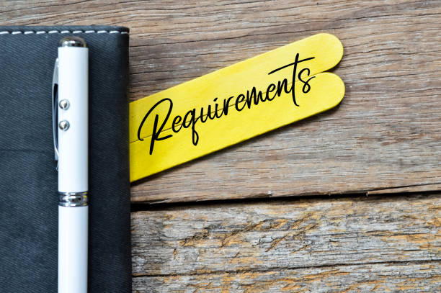
Risk-Based Fraud Monitoring
Establish and implement processes or procedures to identify ACH entries initiated due to fraud.
  Unauthorized entries
  False Pretense
  These processes should be reviewed at last annually to remain effective.
RDFI Credit Monitoring
Key Requirements
RDFIs must implement risk-based processes to monitoring incoming ACH credit transactions to help identify suspicious or potentially fraudulent credits. The extends fraud monitoring responsibilities to include the receipt side of ACH transactions.

Slide 8


Non-Consumer Originators
Key Characteristics
Initiates ACH entries for commercial or business purposes
Can send ACH credits (e.g., payroll, vendor payments) or ACH debits (e.g., B2B collections)
Operates through an Originating Depository Financial Institution (ODFI)
Common examples
Employers sending payroll direct deposits
Businesses collecting ACH payments from customers
Property management companies collecting rent via ACH
Government agencies initiating tax or benefit payments
Corporations paying vendors or contractors
Non-consumer Originators typically present higher dollar volumes and greater fraud exposure than consumer activity, which is why Nacha places enhanced due diligence and fraud monitoring requirements on these entities—especially under the 2026 ACH fraud monitoring rules.
A Non-Customer Originator is a business, organization, or government entity that initiates ACH transactions for purposes other than personal, family, or household use.

Slide 9
Originating Depository Financial Institution (ODFI)
How an ODFI works in the ACH process
A business or individual (Originator) authorizes an ACH payment.
The ODFI transmits the ACH file into the ACH Network.
The ACH Operator (example: Federal Reserve) routes the entry.
The Receiving Depository Financial Institution (RDFI) receives the entry and posts them to the Receiver’s account.
Key responsibilites of an ODFI
Ensure ACH entries are properly authorized
Perform due diligence on Originators and Third-Party Senders
Monitor ACH activity for fraud and suspicious behavior
Enforce exposure limits and return rate thresholds
Confirm that ACH entries comply with Nacha Rules

Slide 10

Remember……
      ODFI is an important role because it is the first line of defense in the ACH process. It introduces transactions into the system, therefore it carries financial and compliance liability in the event of unauthorized or fraudulent activity.
Originating Depository
Financial Institution

Slide 11

Sudden spikes in ACH volume or dollar amounts
New originators sending high-dollar credits immediately
Red Flags
Unusual payment timing or routing changes
Multiple returns for unauthorized transactions
Requests to bypass controls or urgency-based instructions

Slide 12

What the Rules Do Not Require
Specific technology or systems
The rules do not require screening of every entry before processing, however procedures must be reasonably intended to detect fraud.

Slide 13



Intent Behind The Changes
Reduce successful fraud attempts
Strengthen overall ACH security and risk management in all areas
Improve fraud detection and recovery across all ACH systems

Slide 14

NACHA ACH Operating Rules
Phase 1 March 20, 2026
RISK MANAGEMENT TOPICS – (Fraud Monitoring Phase 1) | Nacha
Phase 2 June 19, 2026
Helpful Resources
RISK MANAGEMENT TOPICS – (Fraud Monitoring Phase 2) | Nacha

Slide 15

Finovifi Can Help……
      ACH RiskLens

Slide 16
Supports NACHA’s 2026 ACH Requirements
Key Characteristics of ACH RiskLens
Risk-based monitoring of ACH originations
Identification of anomalous ACH activity
Use of standardized ACH metadata
Documented, repeatable monitoring processes
Support for investigation, review, and escalation

Slide 17

Sources Of Information Needed to Implement ACH RiskLens
Customer Information Files (CIF)
Customer to Account Relationships
Daily Account Balance Information
Daily Account Transaction Information
ONUS ACH Files
Any other ACH Processing Files

Slide 18

Risk Based Transaction Scoring
Key Features
Each ACH entry is evaluated using transaction context and up to 90 days of historical behavior
ACH-Specific Risk Logic
Risk scoring incorporates fraud scenarios such as:
Unauthorized ACH activity
Social engineering and account compromise
Elder financial exploitation
First-time or newly changed originators, SEC codes, or counterparties

Slide 19
Anomaly Detection
Key Features
ACH RiskLens identifies out-of-pattern behavior such as:
Unusual amounts relative to historical norms
Abnormal frequency, velocity, or burst activity
New or infrequent counterparties
Material behavioral shifts over time
Metadata-Aware Analysis
Metadata-Aware AnalysisStandardized ACH descriptors (e.g., PAYROLL, PURCHASE) are incorporated into risk scoring, with reporting on metadata usage and compliance alignment.

Slide 20
It’s Time To Get Prepared…
Don’t Wait

Slide 21

Contact Us
Starr Largin
slargin@finovifi.com
(205) 541-2127

